Slide 1
Vision

Slide 2
AGENDA
1)Introduction
2)Diagrams
3)Projections
4)Real Life Example

Slide 3
Introduction
1/4
Problem Statement
Literature Review

Slide 4
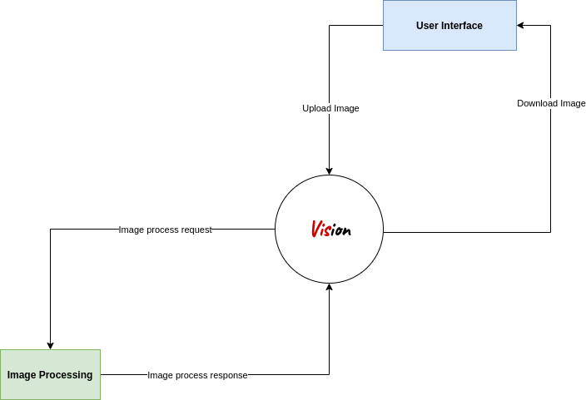
1/4

Slide 5
1/4
Literature Review

Slide 6
AGENDA
1)Introduction
2)Diagrams
3)Projections
4)Real Life Example

Slide 7
Diagrams
2/4
Class
Use Case
Activity
Sequence
State Machine

Slide 8
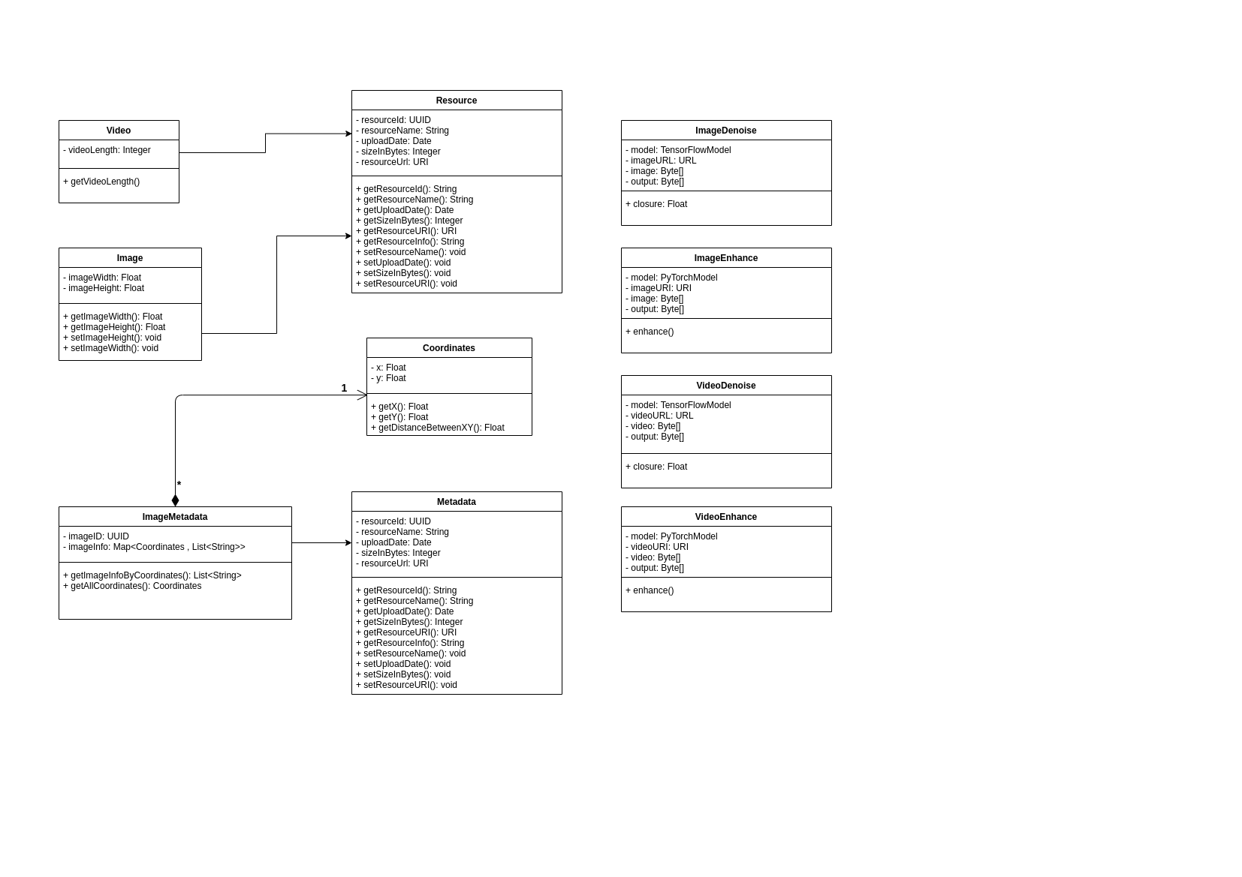
CLASS DIAGRAM
2/4

Slide 9
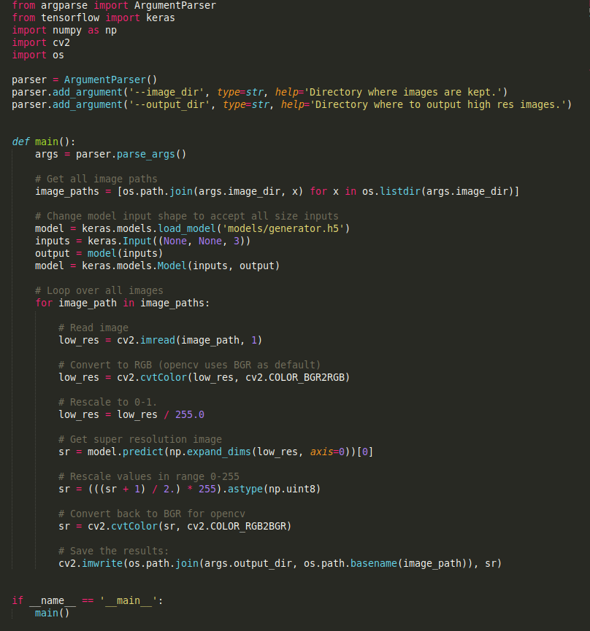
CLASS DIAGRAM
2/4
ONE SCRIPT TO RULE THEM ALL

Slide 10
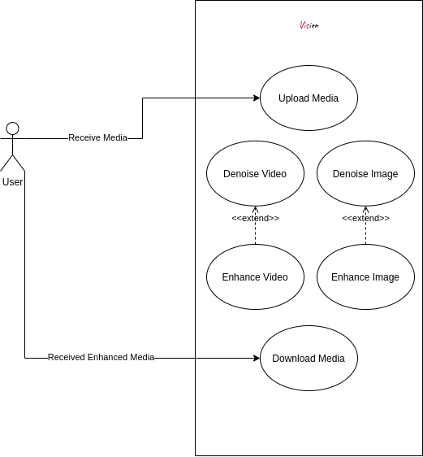
USE CASE DIAGRAM
2/4

Slide 11
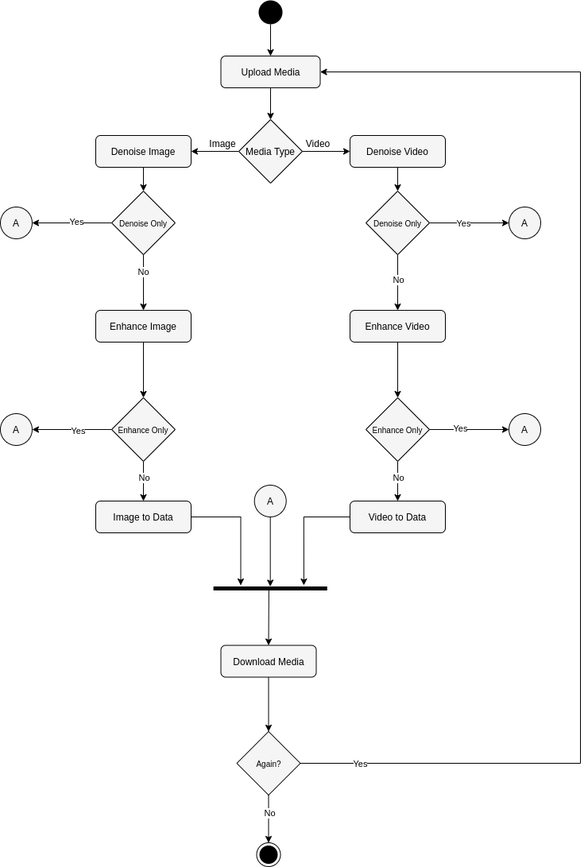
2/4
ACTIVITY DIAGRAM

Slide 12
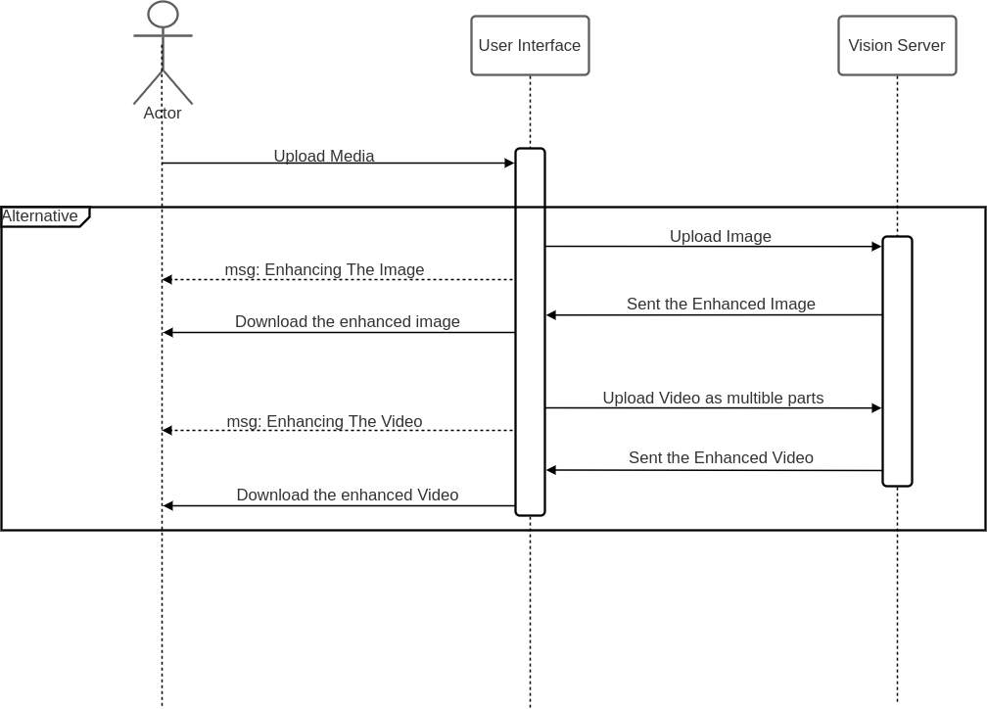
SEQUENCE DIAGRAM
2/4

Slide 13
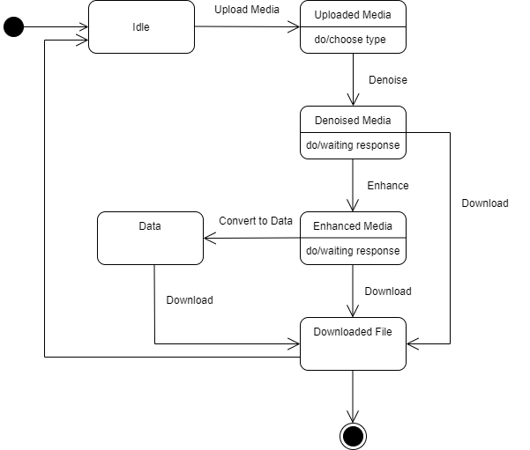
STATE MACHINE DIAGRAM
2/4

Slide 14
AGENDA
1)Introduction
2)Diagrams
3)Projections
4)Real Life Example

Slide 15
Projections
3/4
Gantt Chart
Network Diagram

Slide 16
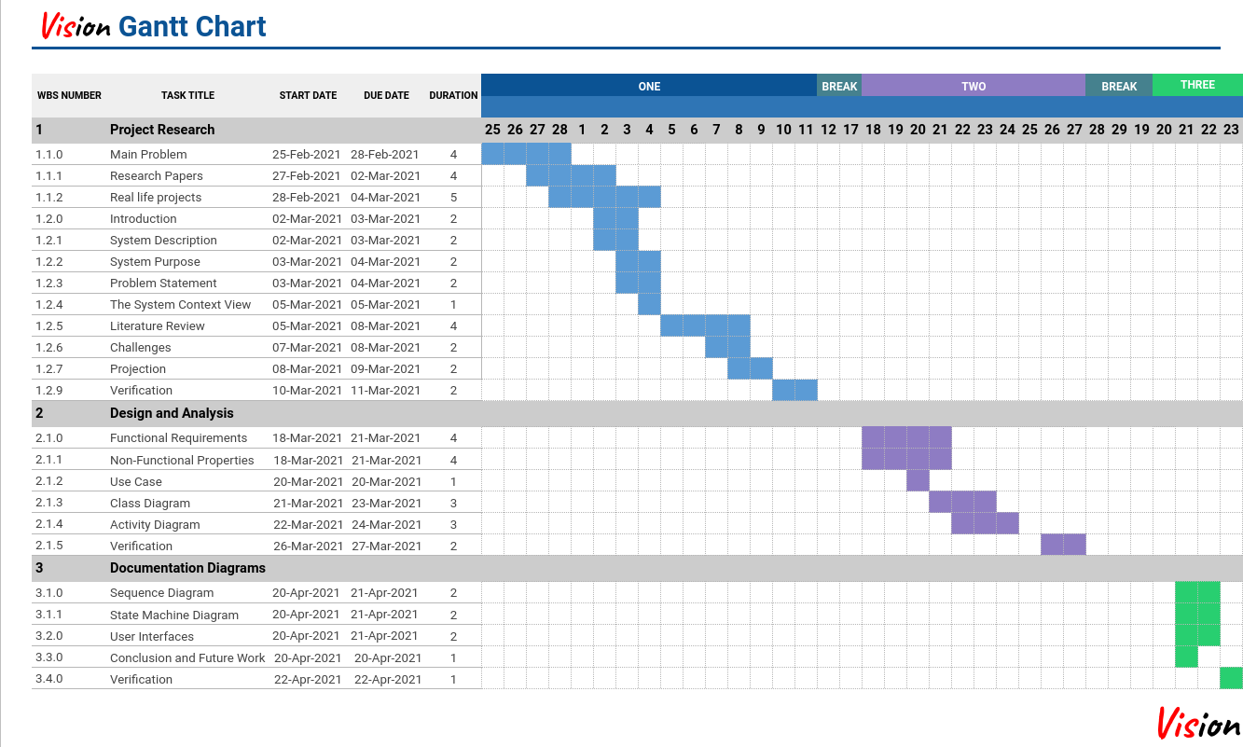
3/4
This was wrong in the final documentation submission

Slide 17
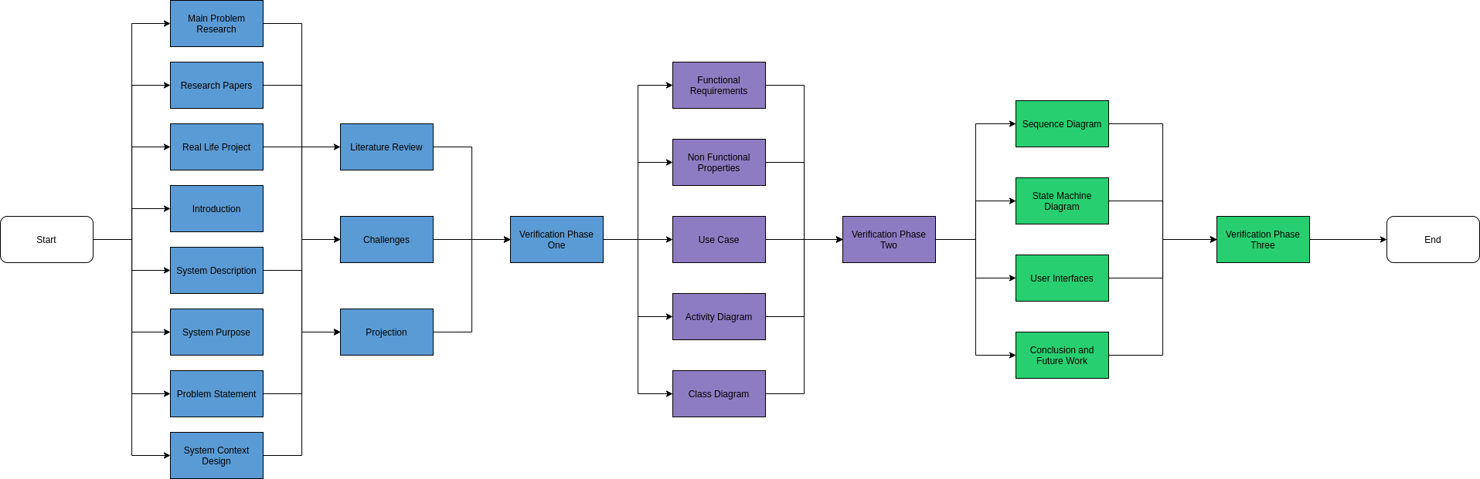
3/4
Network Diagram

Slide 18
AGENDA
1)Introduction
2)Diagrams
3)Projections
4)Real Life Example

Slide 19
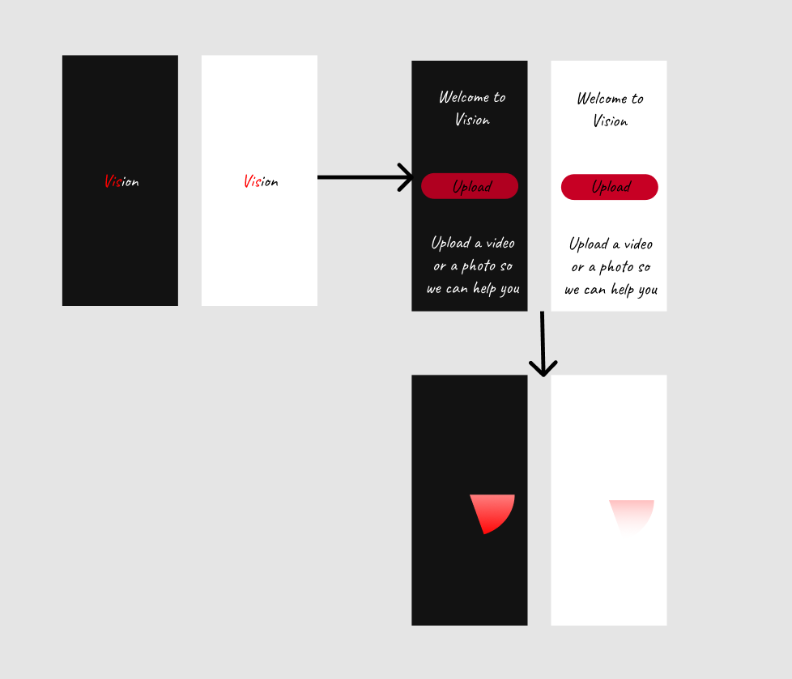
Real Life Example
2/4
User Interfaces
Conclusion and Future work

Slide 20
4/4
Conclusion and Future work

